Slide 1

Department of Biotechnology
THE OXFORD COLLEGE OF ENGINEERING
Bommanahalli, Bangalore-560068.
(VTU Affiliated, AICTE Approved and NBA accredited)
PHASE II PROJECT PRESENTATION
ON
Identification of Deleterious SNPs and Their Effects on Structural Level in GBA1 Gene
Presented by:
Gagan KC (1OX21BT009)
Govindaraju HN (1OX21BT010)
Harini R(1OX21BT011)
Kowshalya C(1OX21BT015)
Guide:
Dr. Amulya Giridasappa
Associate Professor
Dept. of Biotechnology
Head of the Department:
Dr. B K Manjunath
Professor & Head Dept. of Biotechnology

Slide 2
CONTENTS
CHAPTER NO | CHAPTER TITLE | PAGE NO
1 | ABSTRACT | 3-4
2 | INTRODUCTION | 5-13
3 | LITERATURE REVIEW | 14-19
4 | OBJECTIVES | 20-21
5 | METHODOLOGY | 22-50
6 | RESULTS | 51-60
7 | REFERENCES | 61-62

Slide 3
ABSTRACT

Slide 4
ABSTRACT
The aim of our study is to identify probable deleterious genetic variations that can alter the expression and the function of the GBA1 gene using in silico methods. Of the 4922 SNPs identified in the GBA1 gene,530 were found to be missense.
The missense SNPs were recorded with their genetic mutations and tested for their effect on the disease with various sequence-based software's like PolyPhen-2, SNP& GO, FATHMM, PhD-SNP, SNAP, SIFT, PANTHER, META-SNP to predict the major mutations that affect the structure of the protein. Further theses major mutations are tested for their effect on the disease with few structure-based software's like Mupro, I-MUTANT, I STABLE, DUET, DynaMut2 . The major mutations predicted to affect the structure of the protein by the trajectory run in molecular dynamics studies. The random transition of the protein structures over the simulation period caused by these mutations hints at how the native state is distorted which could lead to the loss of structural stability and functionality. Based on this work, we can propose the SNP which will have comparatively more deleterious effects than the other predicted mutations in destabilizing the protein structure.
Keywords: GBA1 , PolyPhen-2, SNP& GO, FATHMM, PhD-SNP, SNAP, SIFT, PANTHER, META-SNP, Mupro, I-MUTANT, I STABLE,DUET,DynaMut2, Molecular dynamics.

Slide 5
INTRODUCTION

Slide 6
INTRODUCTION
Gaucher's disease is a genetic disorder caused by mutations in the GBA gene, which provides instructions for making an enzyme called glucocerebrosidase. (Grabowski et al. 2001)
This enzyme breaks down a fatty substance called glucocerebroside into simpler molecules. When there is a mutation in the GBA gene, the enzyme doesn't function properly, leading to a buildup of glucocerebroside in various cells, particularly in the liver, spleen, bone marrow, and sometimes the brain. (Beutler et al. 1971)
The buildup causes the cells to become engorged, which leads to the enlargement of organs, skeletal abnormalities, anemia, and other symptoms associated with Gaucher's disease. There are different types of Gaucher's disease. (Brady et al. 1965)

Slide 7
Types of Gaucher Disease
Type 1 (non-neuropathic):
Individuals with Type 1 Gaucher disease can have a near-normal life expectancy with appropriate treatment. Symptoms such as hepatosplenomegaly, anemia, and thrombocytopenia often improve with enzyme replacement therapy (ERT).Bone disease may progress more slowly or stabilize with ERT, but residual skeletal abnormalities can persist. Most common, affects the liver, spleen, and bones. (Futerman et al. 2004)
2. Type 2 (Acute Neuropathic Form):
Type 2 Gaucher disease is a severe and rapidly progressing form, primarily affecting infants. The prognosis for Type 2 is generally poor, with a significantly reduced life expectancy. Affected children often experience neurological decline and severe complications in infancy or early childhood. (Cox et al. 2003)

Slide 8
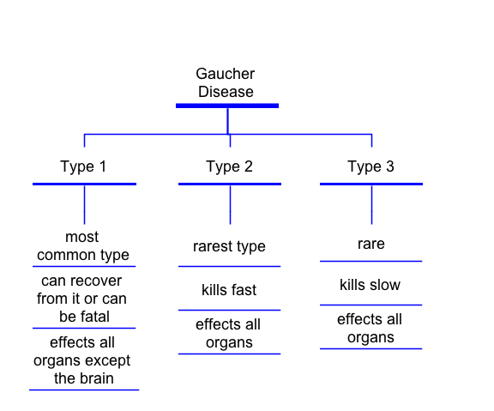
3. Type 3 Gaucher Disease (Chronic Neuropathic Form):
Type 3 Gaucher disease is a milder form than Type 2, with a later onset of symptoms, typically in childhood or adolescence. Prognosis varies widely, with some individuals having a relatively stable course while others may experience more significant neurological involvement. (Zimran et al. 1992)
Fig.2.1. Schematic Representation of types of Gaucher disease

Slide 9
Protein Coding of Gaucher Disease
Protein mutations are responsible for Gaucher disease. Specifically, mutations in the GBA gene, which codes for the enzyme glucocerebrosidase, lead to this disorder. (Balwani et al. 2010)
The mutations alter the structure and function of the enzyme, making it either non-functional or severely impaired. (Charrow et al. 2000)
This results in the accumulation of the fatty substance glucocerebroside in cells, particularly in macrophages, leading to the symptoms of Gaucher disease. (Sidransky et al. 2004)
Over 4922 mutations of the GBA gene have been identified, including missense, frameshift, and nonsense mutations, all of which can affect the protein's folding, stability, and enzymatic activity which has 530 missense mutation. (Schiffmann et al. 2002)

Slide 10
These mutations range in severity, influencing whether a person develops type 1, 2, or 3 Gaucher disease, with some mutations linked to more severe neuronopathic forms (types 2 and 3). (Kaplan et al. 1993)
The GBA gene codes for the protein glucocerebrosidase through the typical process of gene expression, which involves two key stages: transcription and translation. (Rosenbloom et al. 2011)
1. Transcription (DNA to mRNA):The GBA gene is located on chromosome 1 and consists of DNA sequences. (Pastores et al. 2004)
When the gene is activated, a segment of DNA is transcribed into messenger RNA (mRNA) by an enzyme called RNA polymerase.(Elstein et al. 1997)
During transcription, the DNA sequence of the GBA gene serves as a template, and complementary RNA bases are assembled to form a strand of mRNA.This mRNA strand is a copy of the gene's coding sequence, carrying the information needed to produce the protein. (Mistry et al. 2009)

Slide 11
2. Translation (mRNA to Protein):The mRNA exits the nucleus and enters the cytoplasm, where it attaches to a ribosome, the cellular machinery that synthesizes proteins. (Kacena et al. 2003)
The ribosome reads the mRNA sequence in sets of three bases called codons, each codon specifying a particular amino acid. Transfer RNA (tRNA) molecules bring the appropriate amino acids to the ribosome based on the codons in the mRNA. (van Dussen et al. 2014)
NOTE:
Mutations in the GBA Gene: If there are mutations in the DNA sequence of the GBA gene, the transcription or translation process may produce a faulty or non-functional glucocerebrosidase protein. (Andersson et al. 2005)
These mutations can lead to defective enzyme function, resulting in the lipid accumulation characteristic of Gaucher's disease. (Hollak et al. 1994)

Slide 12
Worldwide Statistics
Gaucher disease, though rare, is the most common lysosomal storage disorder (LSD) both globally and in India. The prevalence of Gaucher disease varies significantly by region. (Peterschmitt et al. 2011)
Worldwide, the incidence ranges from 0.45 to 25 per 100,000 live births depending on the population studied. In countries like the U.S. and parts of Europe, Gaucher disease type 1 is more common, with an estimated prevalence of 0.70 to 1.75 per 100,000 people. (Gonzalez et al. 2015)
Types 2 and 3, which are rarer and often more severe, are found less frequently, with prevalence estimates as low as 0.02 to 0.08 per 100,000. (Martins et al. 2009)

Slide 13
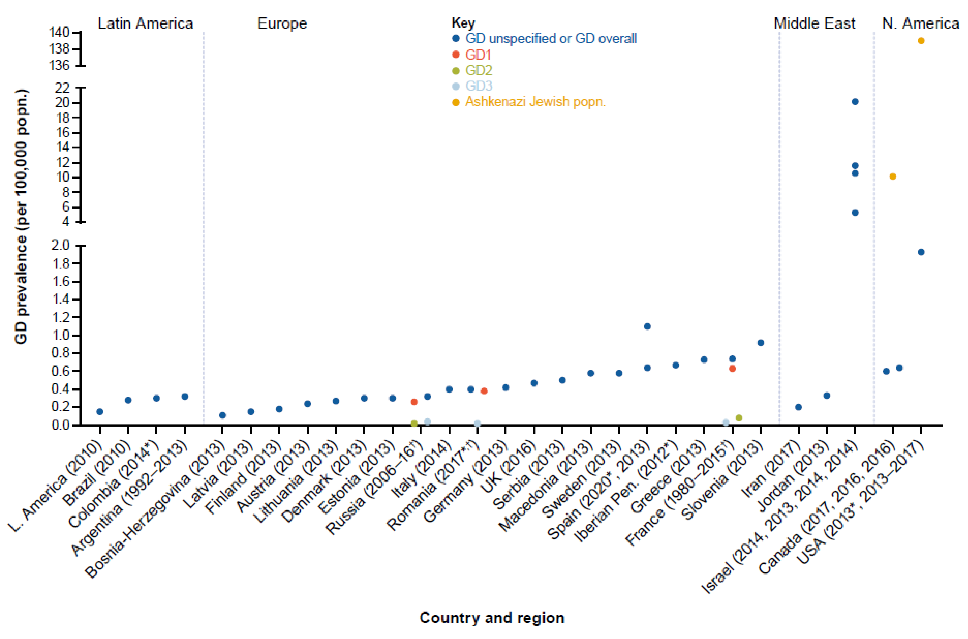
Fig.2.2. Graph of Worldwide Statistics of Gaucher Disease

Slide 14
Literature Review

Slide 15
Literature Review
AUTHOR AND YEAR | TITLE | JOURNAL | RESEARCH FINDINGS
Neil Weinreb et.al. (2004) | Gaucher disease type 1 and its evaluations and monitoring on adult patients | Science Direct | Comprehensive review of the Gaucher disease type 1, challenges faced by patients, and recommendations for monitoring.
Jack Goldblatt et.al. (2013) | Long-term clinical outcomes in type 1 Gaucher disease | Springer | A review of long-term effects, treatment methods, and responses in type 1 Gaucher disease.
Hruska et.al. (2008) | Gaucher disease mutation and polymorphism spectrum in the glucocerebrosidase gene (GBA) | Wiley Online Library | Explores mutations in the GBA gene and their association with Gaucher disease.
Daniel Grinberg et.al. (2004) | Functional analysis of 13 GBA mutant alleles identified in Gaucher disease patients | Wiley Online Library | Focuses on 200+ mutations in GBA worldwide and their causality in Gaucher disease.

Slide 16
AUTHOR AND YEAR | TITLE | JOURNAL | RESEARCH FINDINGS
Walker et.al. (2002) | The identification of eight novel glucocerebrosidase (GBA) mutations in patients with Gaucher disease | Wiley Online Library | Identified seven novel missense mutations and one splice site mutation in GBA gene.
Marc Berger et.al. (2017) | A Review of Gaucher Disease Pathophysiology, Clinical Presentation and Treatments | Springer | Discusses recent advances in Gaucher disease treatment, including new enzymes and inhibitors.
Grace et.al. (2015) | Biochemical and genetic markers in Gaucher disease type 1 | Journal of Inherited Metabolic Disease | Highlights advancements in biochemical markers and enzyme replacement therapy.
Beutler et.al. (2006) | Gene therapy perspectives for Gaucher disease | Human Gene Therapy | Examines CRISPR technology's potential to correct GBA mutations.

Slide 17
AUTHOR AND YEAR | TITLE | JOURNAL | RESEARCH FINDINGS
Cox et.al. (2020) | The impact of substrate reduction therapy on Gaucher disease outcomes | Therapeutic Advances in Rare Disease | Analyzes substrate reduction therapy as an alternative or adjunct to enzyme replacement therapy.
Pastores et.al. (2013) | Neurological involvement in Gaucher disease: Challenges in diagnosis and management | Neurology Journal | Highlights diagnostic complexities and management of neurological symptoms.
Arends et.al. (2018) | Phenotypic variability in Gaucher disease | Journal of Inherited Metabolic Disease | Focuses on genotype-phenotype correlations for personalized treatment.
Rosenbloom et.al. (2011) | Gaucher disease: Pathophysiology and treatment approaches | Current Opinion in Hematology | Reviews pathophysiology and emerging therapeutic strategies.

Slide 18
AUTHOR AND YEAR | TITLE | JOURNAL | RESEARCH FINDINGS
Shachar et.al. (2017) | The role of autophagy in Gaucher disease | Autophagy Journal | Links lysosomal dysfunction to cellular stress and neurodegeneration.
Stirnemann et.al. (2017) | A review of Gaucher disease epidemiology and global burden | Orphanet Journal of Rare Diseases | Explores demographic variations and socioeconomic impact.
Mistry et.al. (2010) | Enzyme replacement and substrate reduction therapies in Gaucher disease | The Lancet | Evaluates effectiveness of different therapeutic approaches.
Peters et.al. (2017) | Pediatric Gaucher disease: Early diagnosis and management | Pediatric Blood & Cancer | Stresses early diagnosis to prevent irreversible complications.

Slide 19
AUTHOR AND YEAR | TITLE | JOURNAL | RESEARCH FINDINGS
Shachar et.al. (2017) | The role of autophagy in Gaucher disease | Autophagy Journal | Links lysosomal dysfunction to cellular stress and neurodegeneration.
Stirnemann et.al. (2017) | A review of Gaucher disease epidemiology and global burden | Orphanet Journal of Rare Diseases | Explores demographic variations and socioeconomic impact.
Mistry et.al. (2010) | Enzyme replacement and substrate reduction therapies in Gaucher disease | The Lancet | Evaluates effectiveness of different therapeutic approaches.
Peters et.al. (2017) | Pediatric Gaucher disease: Early diagnosis and management | Pediatric Blood & Cancer | Stresses early diagnosis to prevent irreversible complications.

Slide 20
OBJECTIVES

Slide 21
OBJECTIVES
The objective of the project is
To Identify deleterious SNP’s using sequence-based approach.
To Identify of deleterious SNP’s using Structure based approach of gene.
To understand the gene structure stability using molecular dynamic simulation.

Slide 22
Methodology

Slide 23
Methodology
Data Collection
In Silico Analysis of SNPs
Structural Analysis
Molecular Dynamics Simulation

Slide 24
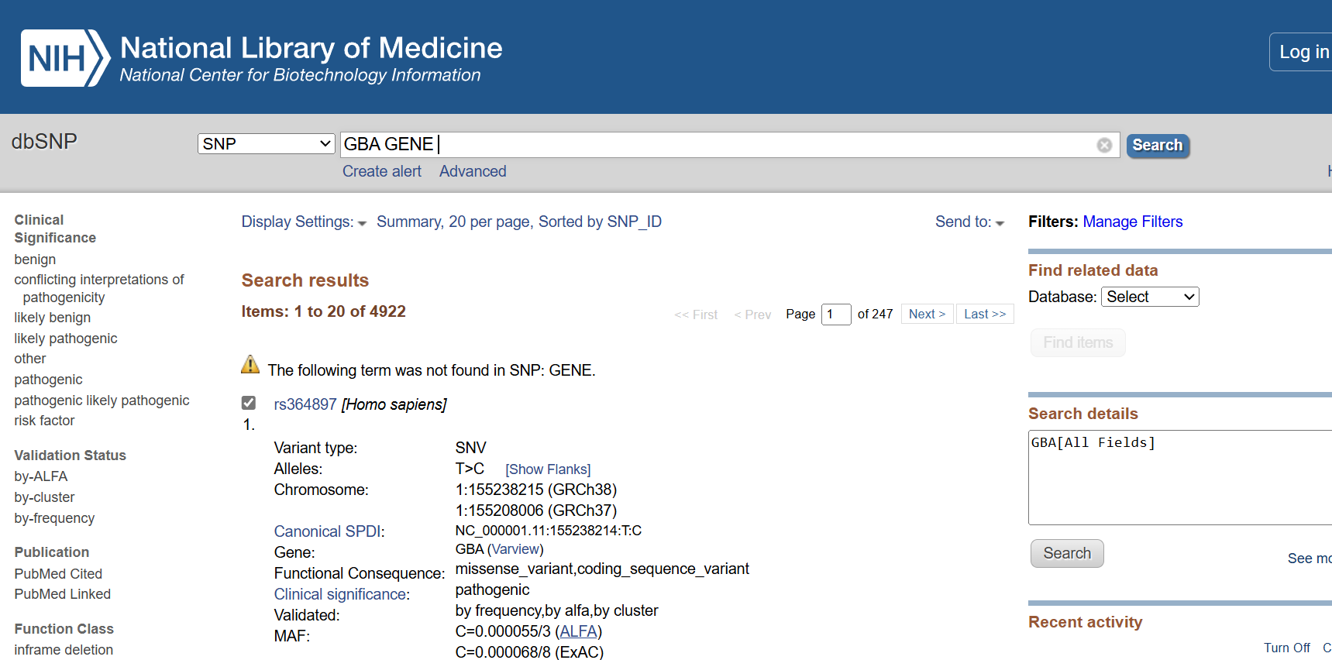
DATA COLLECTION
1.Identification of SNP’s from NCBI website.

Slide 25
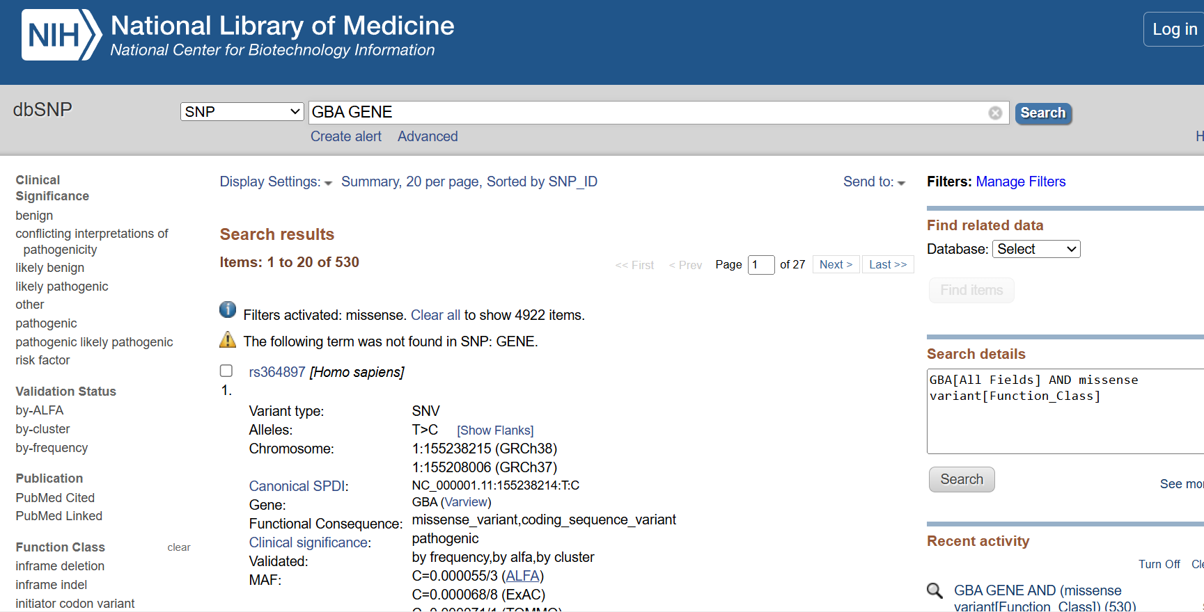
2. Identification of missense SNP’s from NCBI website

Slide 26
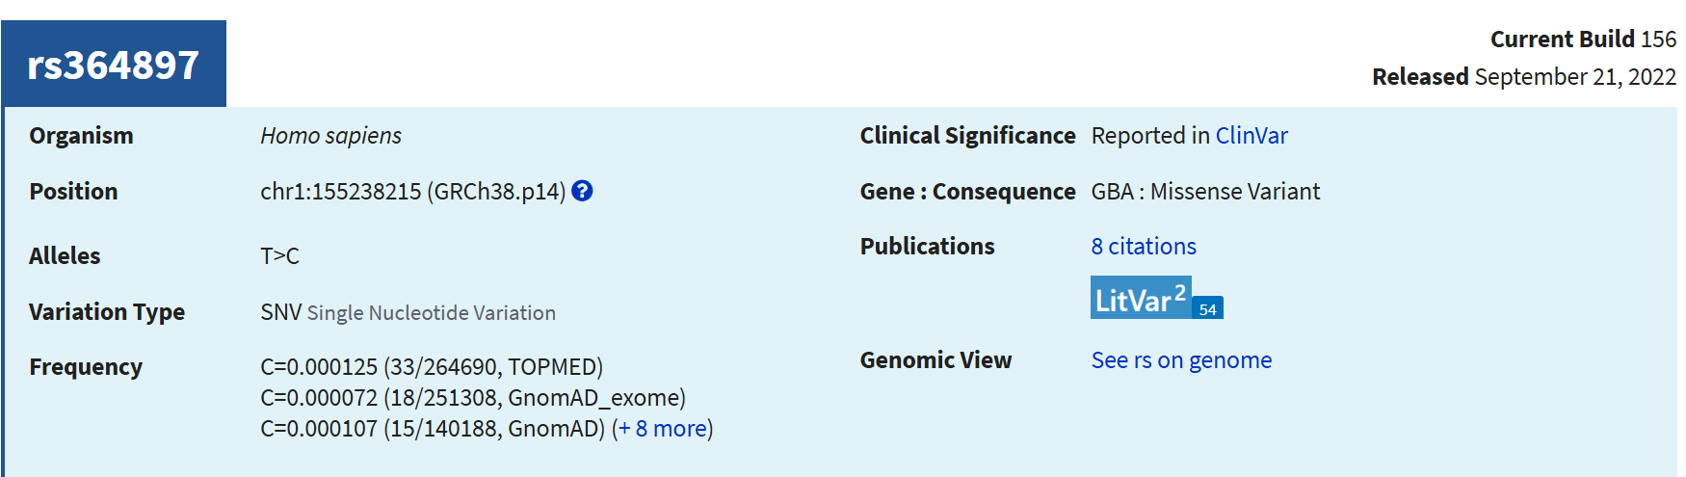
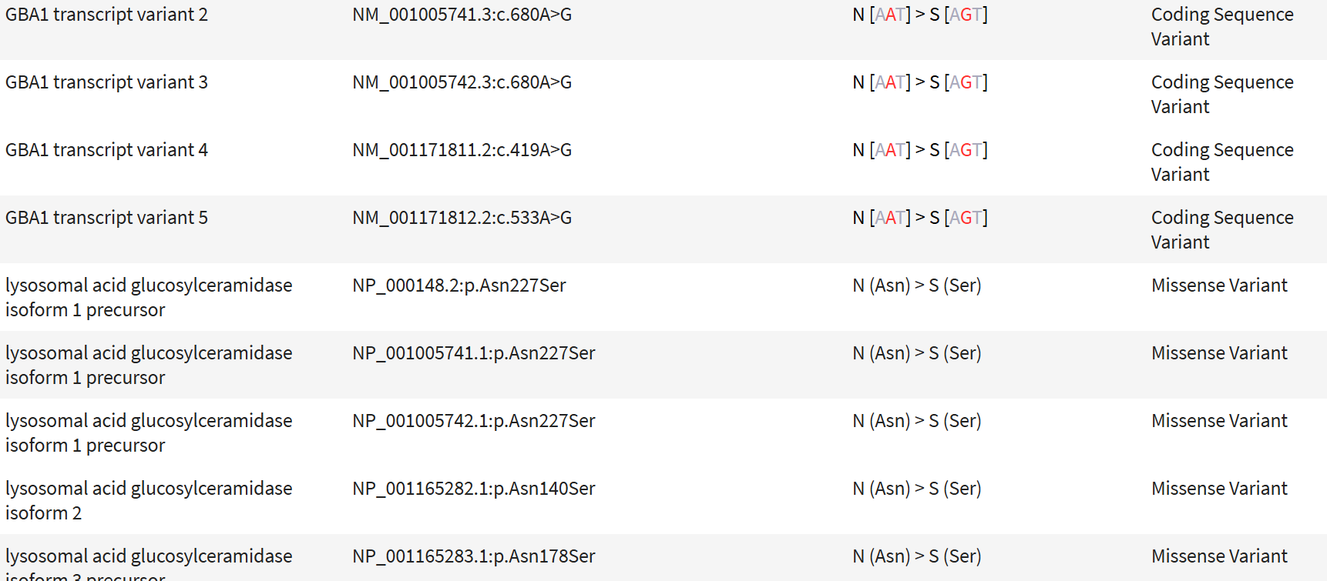
3.Collection of information of SNP’s

Slide 27
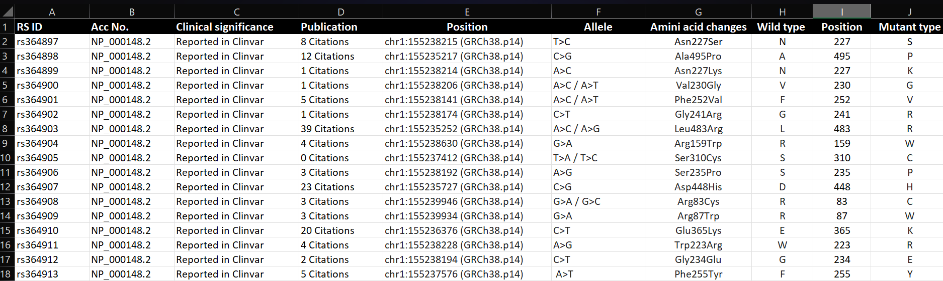
4. Saving the data in an excel sheet

Slide 28
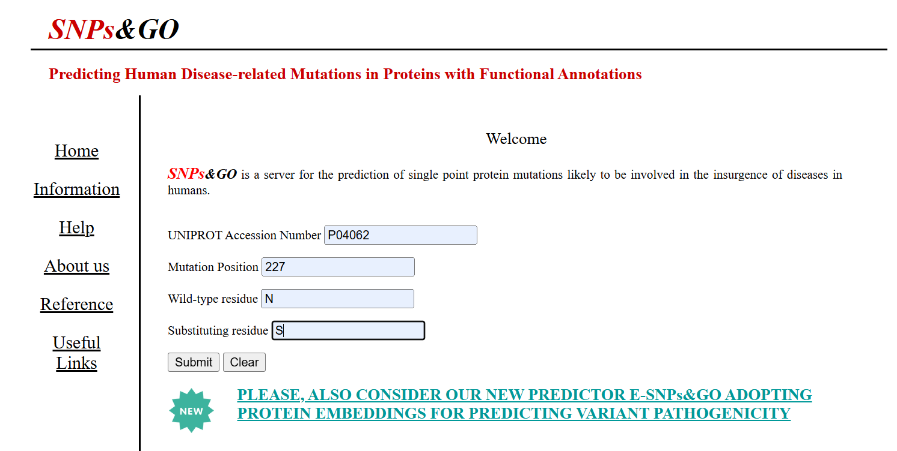
In Silico Analysis of SNPs 1. SNP & GO

Slide 29
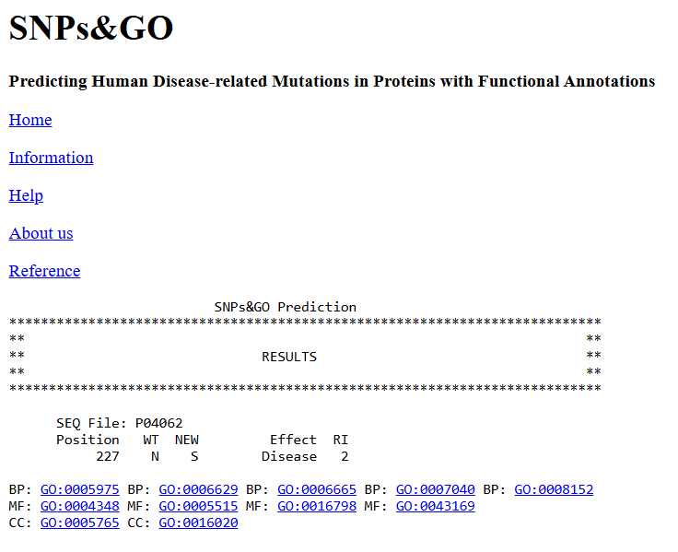
SNP & GO Result Analysis

Slide 30
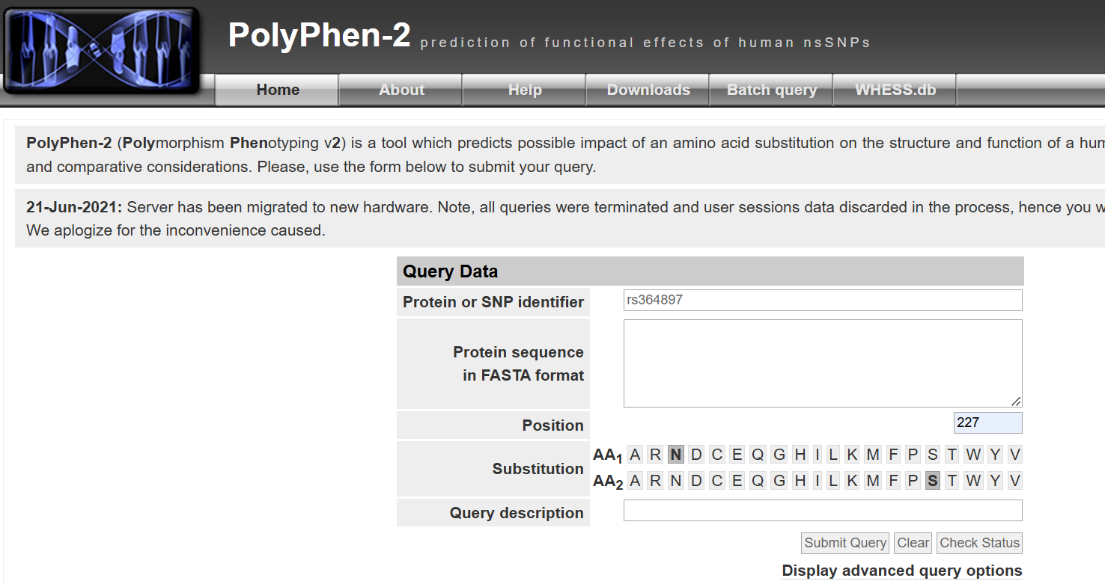
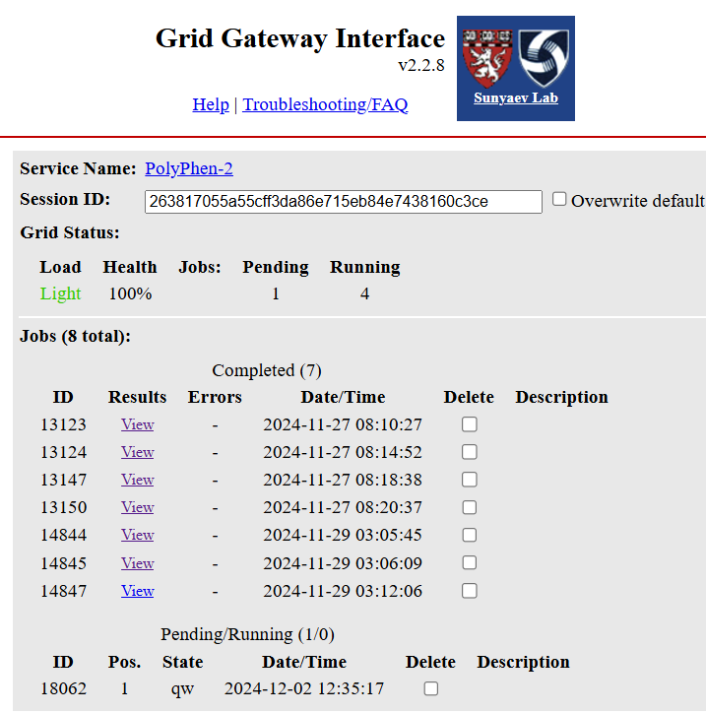
2. PolyPhen-2 Prediction

Slide 31
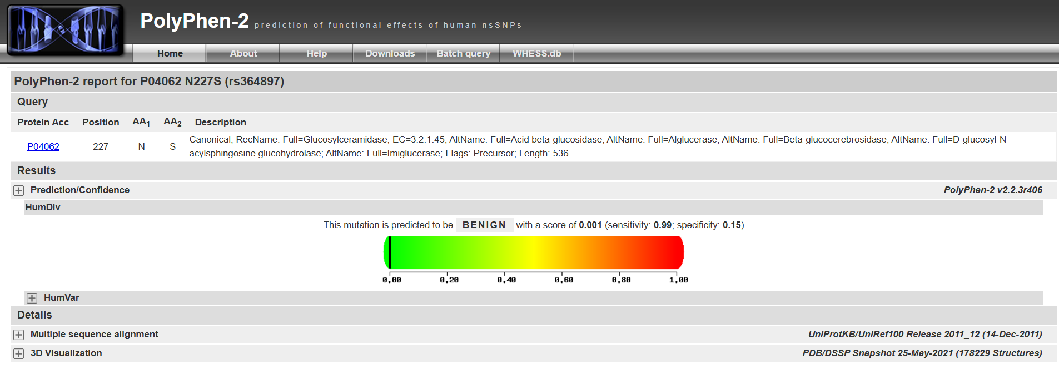
PolyPhen-2 Result

Slide 32
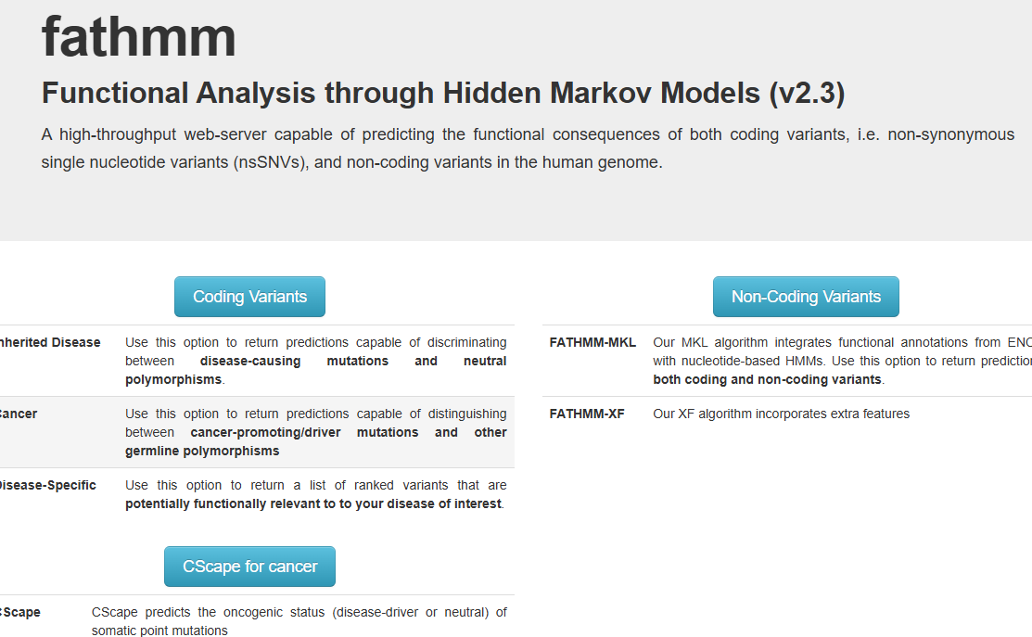
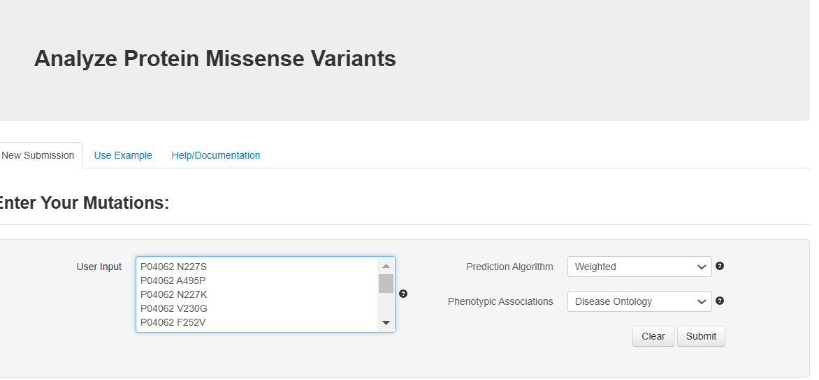
3. FATHMM

Slide 33
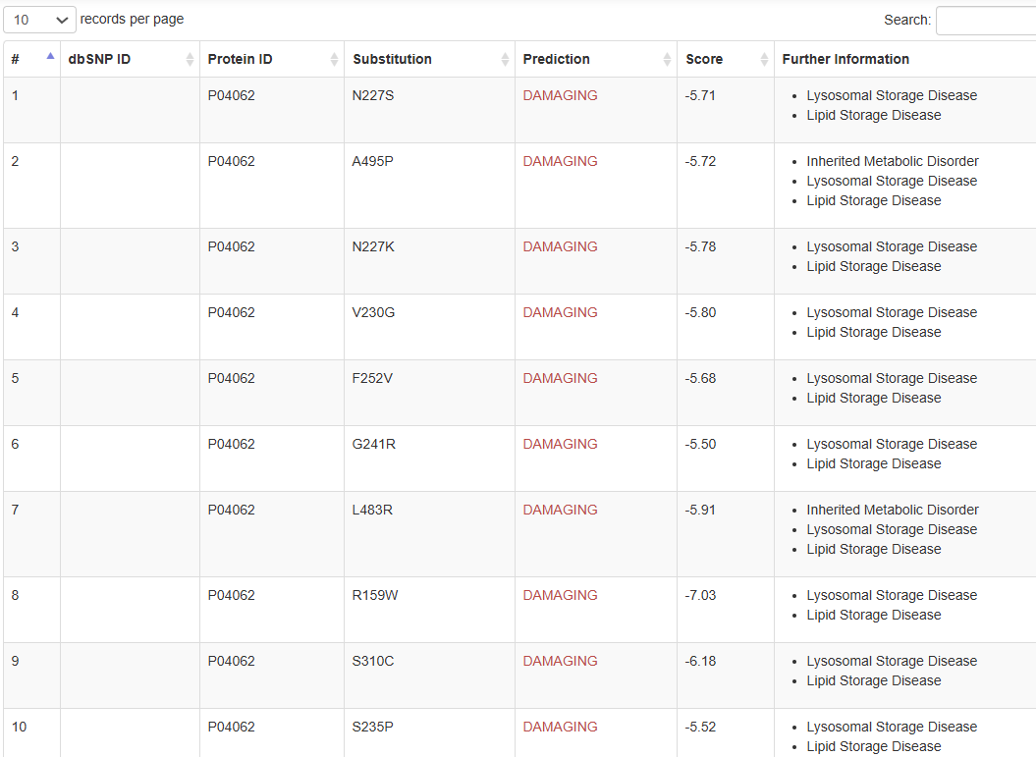
FATHMM Result

Slide 34
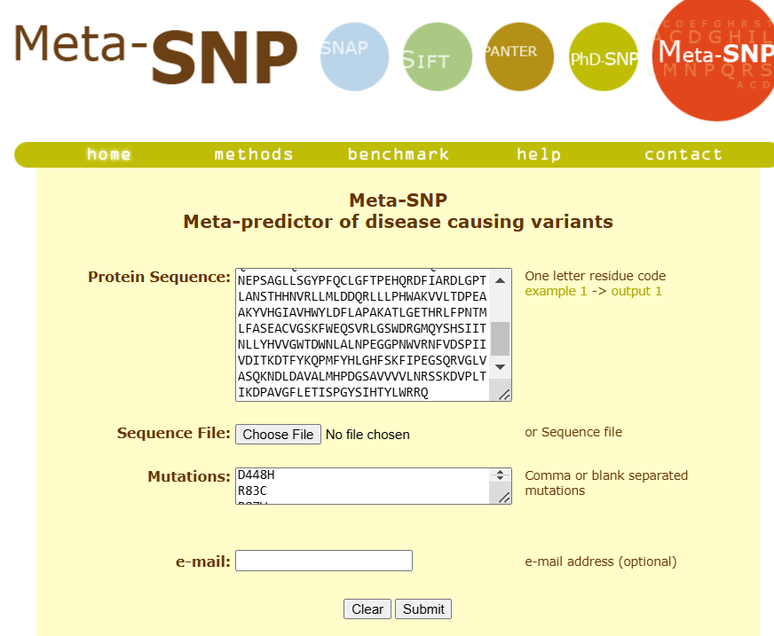
4. Meta-SNP , SNAP, SIFT, PANTER, PhD-SNP

Slide 35
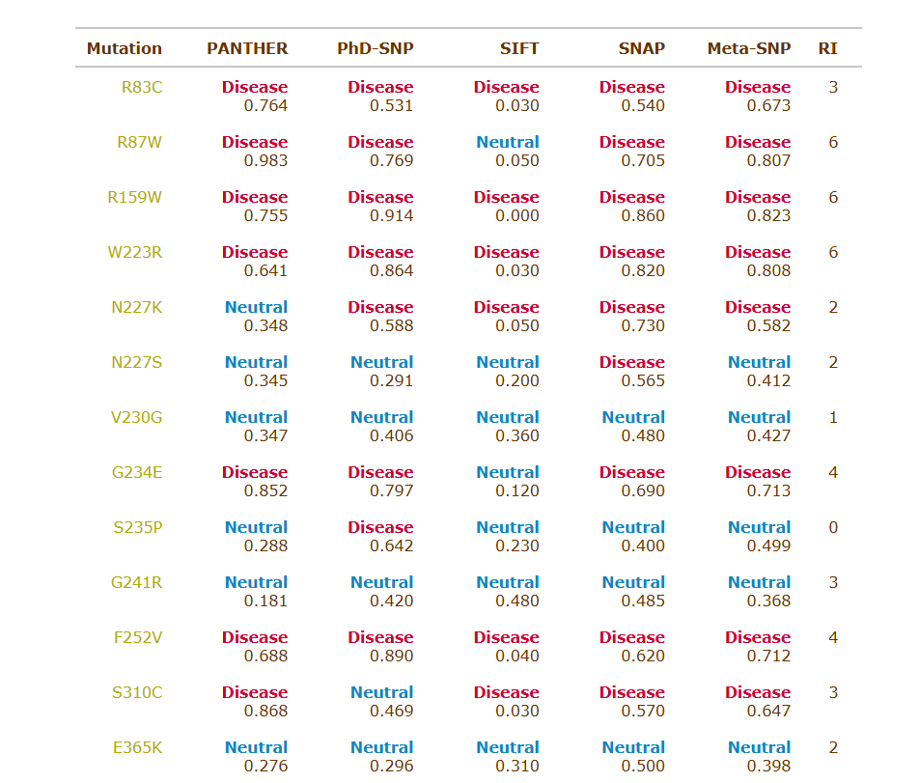
Meta-SNP , SNAP, SIFT, PANTER, PhD-SNP Result

Slide 36
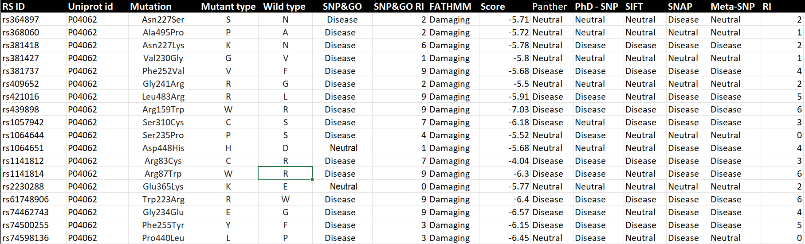
Sequence Based analysis result sheet

Slide 37

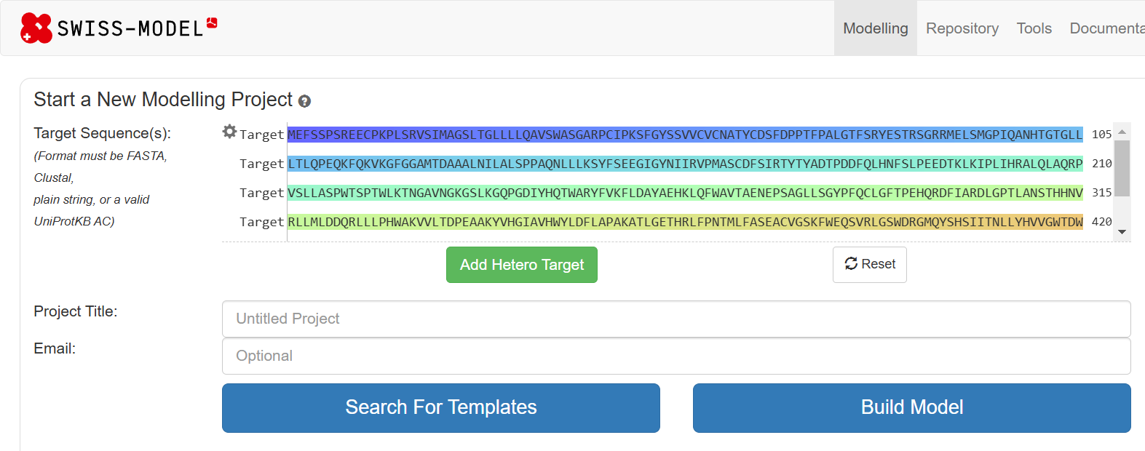
Structural Analysis
Protein structure development

Slide 38
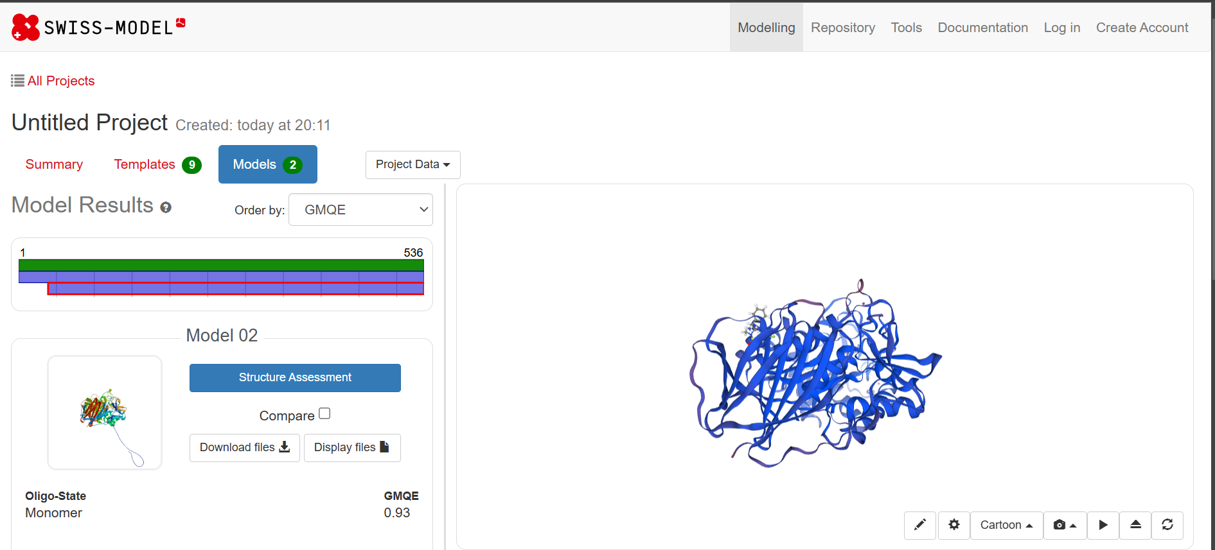

Slide 39
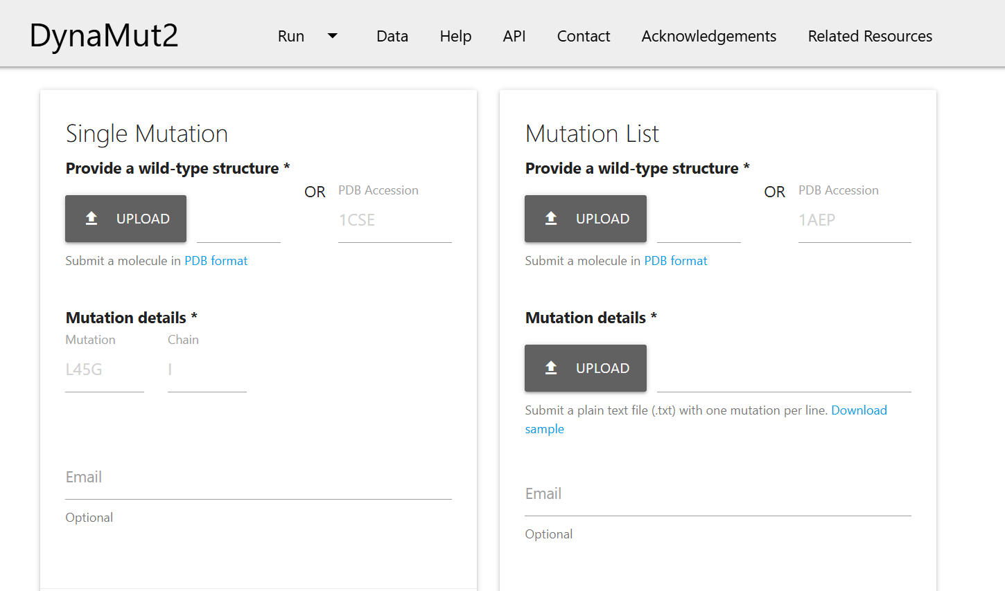
1. DYNA MUT 2

Slide 40
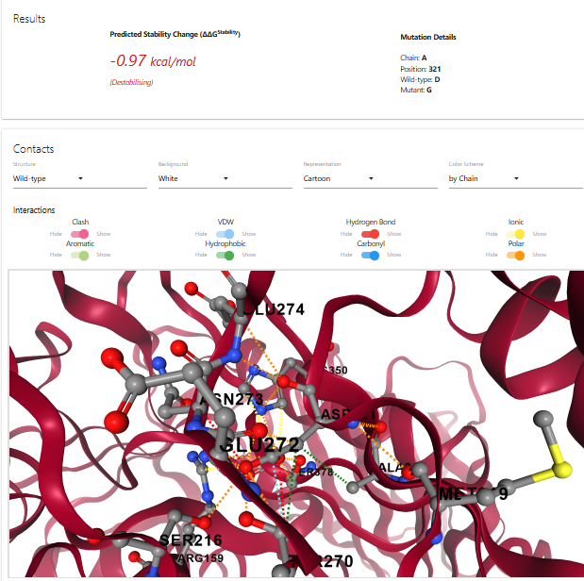
DYNA MUT 2 RESULT

Slide 41
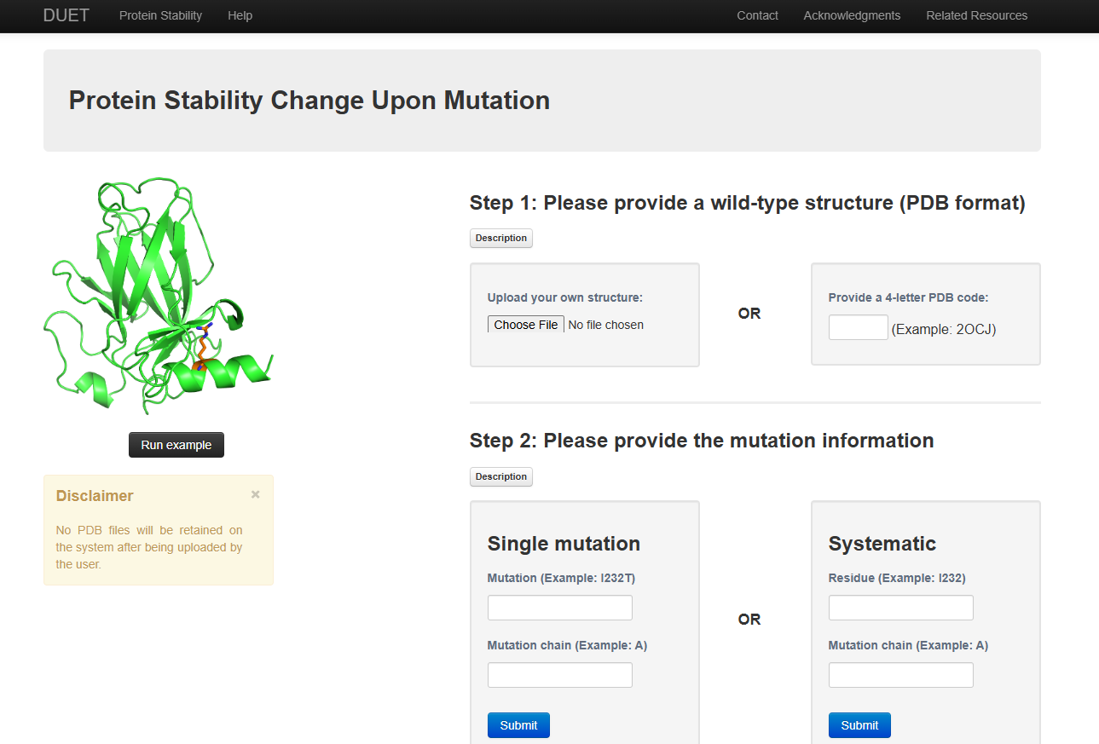
2.DUET

Slide 42
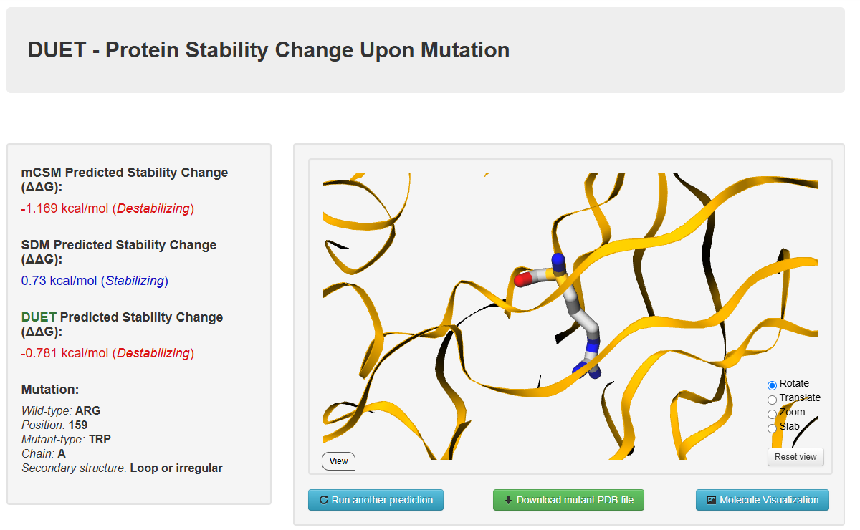
DUET RESULT

Slide 43
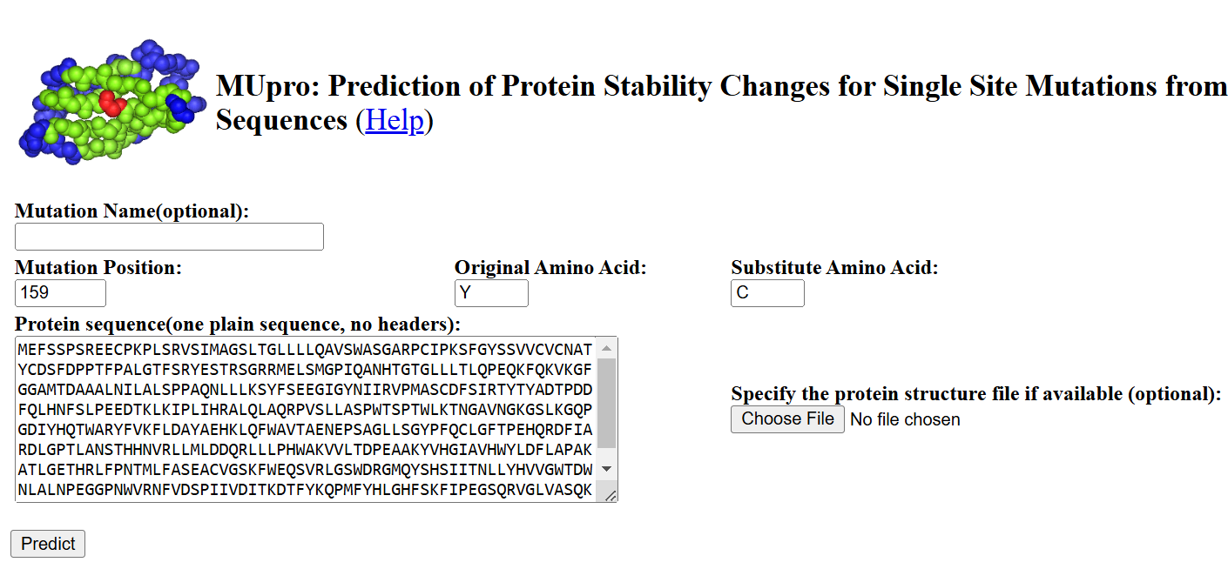
3. MUPRO

Slide 44
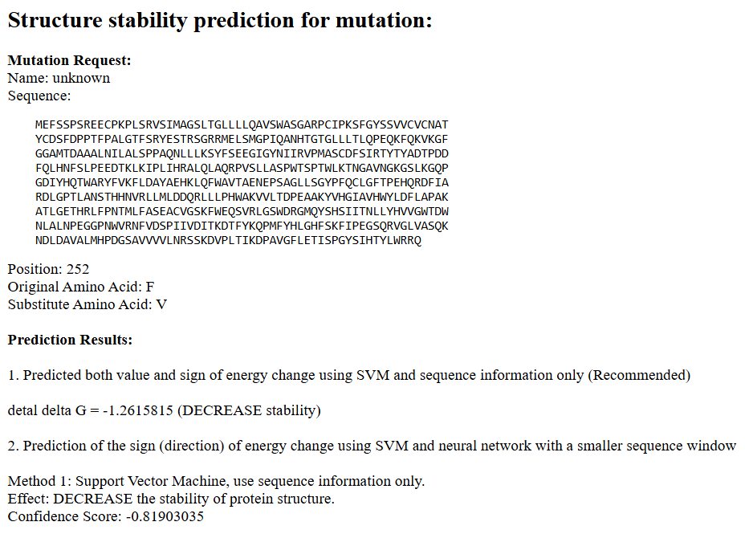
MUPRO RESULT

Slide 45
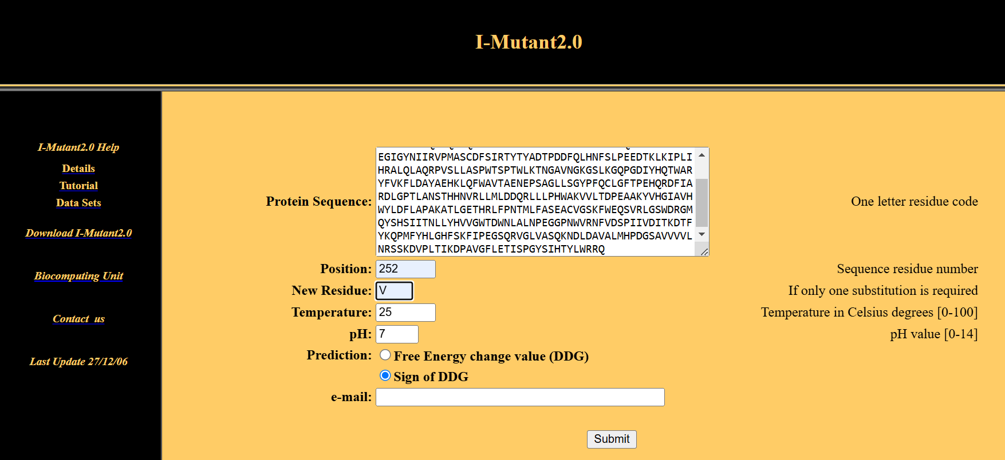
4. I-MUTANT

Slide 46
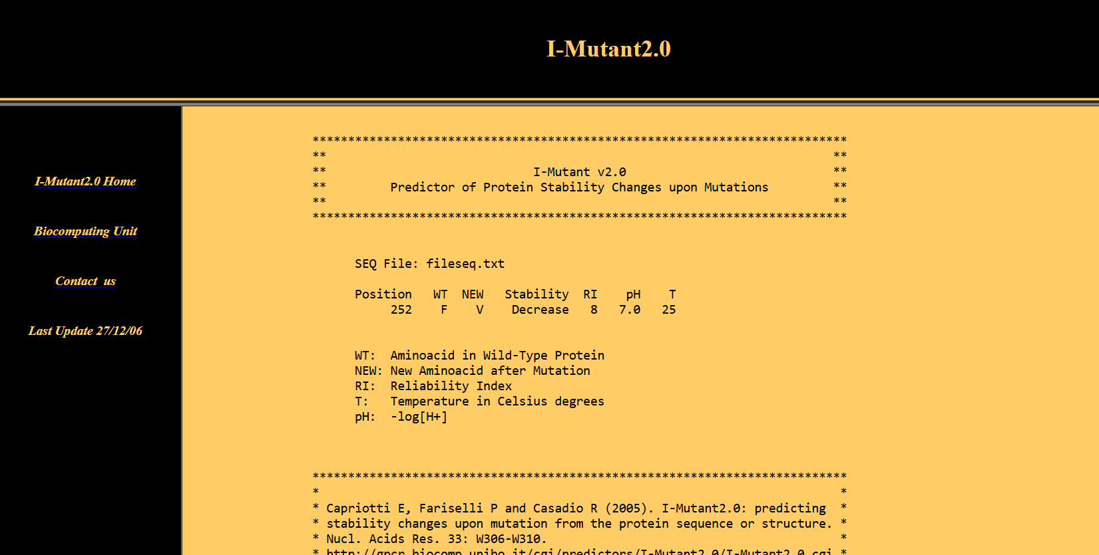
I-MUTANT RESULT

Slide 47
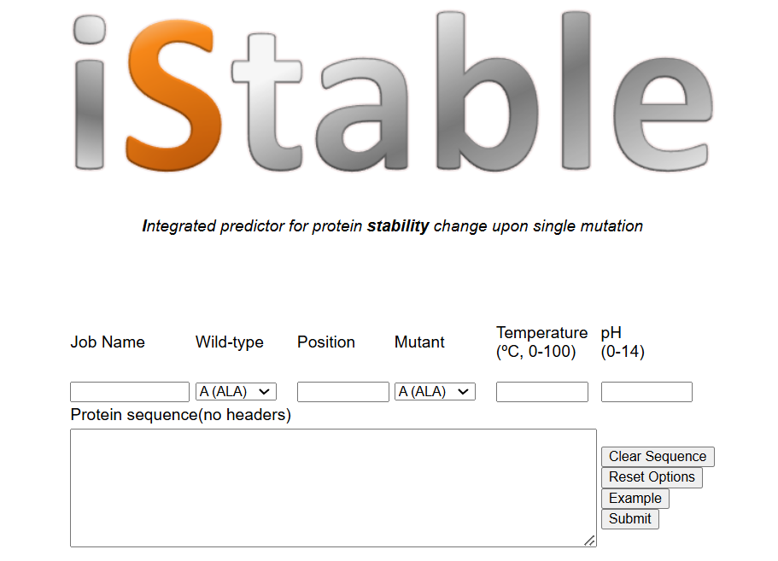
5. I-STABLE

Slide 48
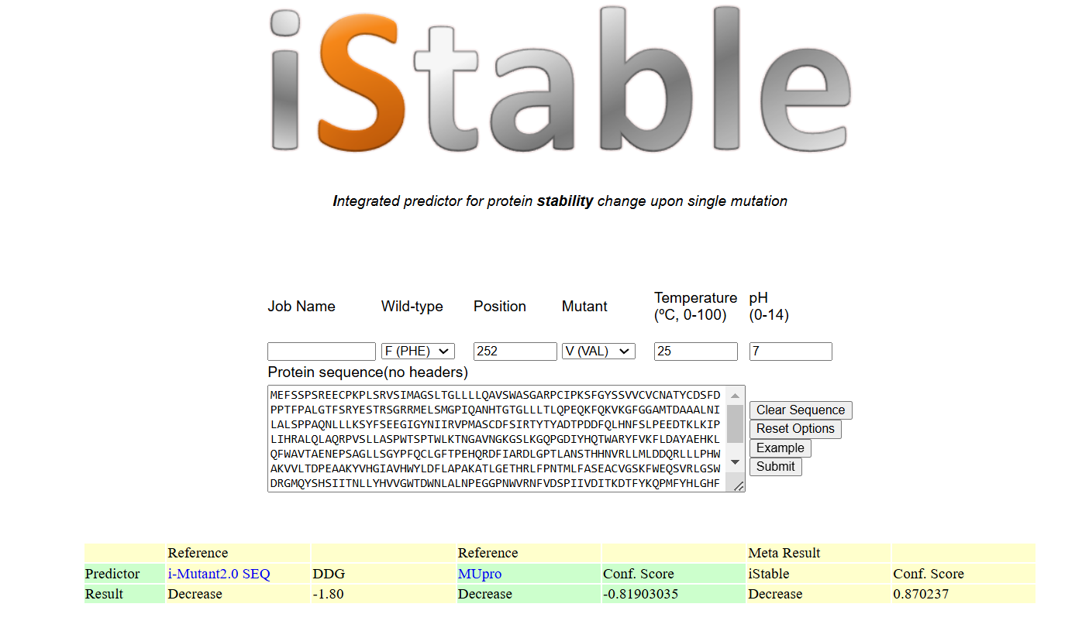
I-STABLE RESULT

Slide 49
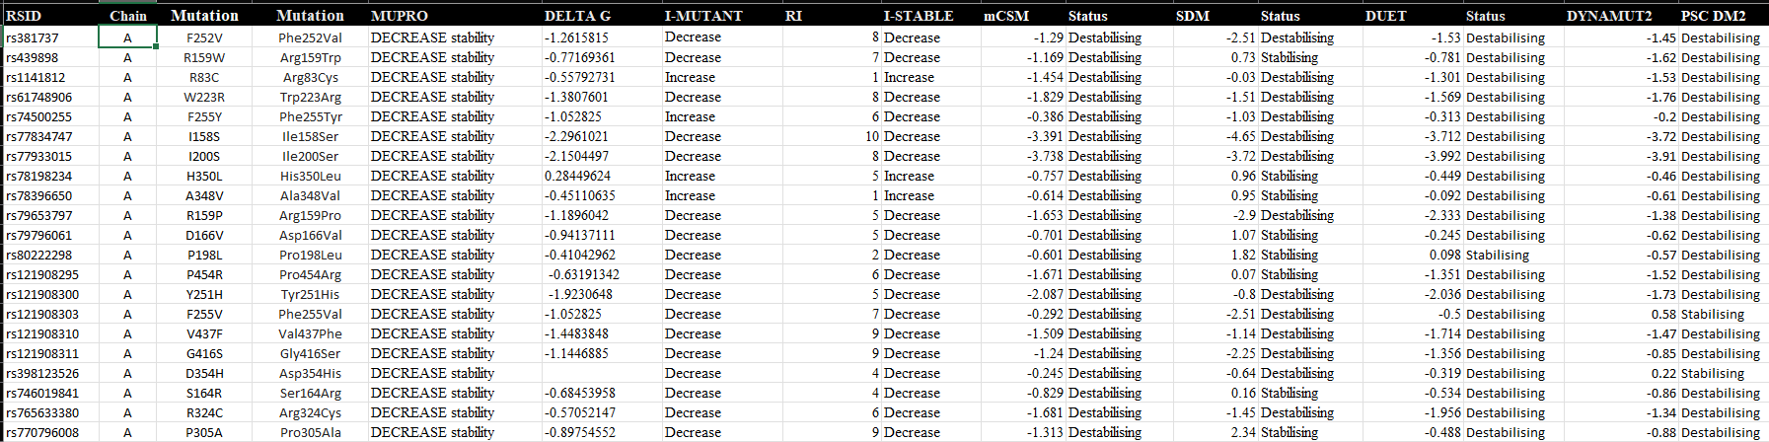
Structure Based analysis result sheet

Slide 50
Molecular dynamics
Molecular dynamics simulations were performed on the wild-type and three mutant variants of the protein.
The pdb2gmx module of GROMACS was utilized to add hydrogen atoms to the heavy atoms.
The resulting simulation trajectories were analyzed using various tools from the GROMACS software package to evaluate key structural and dynamic properties.
These analyses included protein root mean square deviation (RMSD), root mean square fluctuation (RMSF), radius of gyration (Rg), solvent-accessible surface area (SASA), and hydrogen bonding(H-bond) interactions.
System preparation followed the methodology described in a previously published study [PMID: 31514687].

Slide 51
RESULTS & DISCUSSION

Slide 52
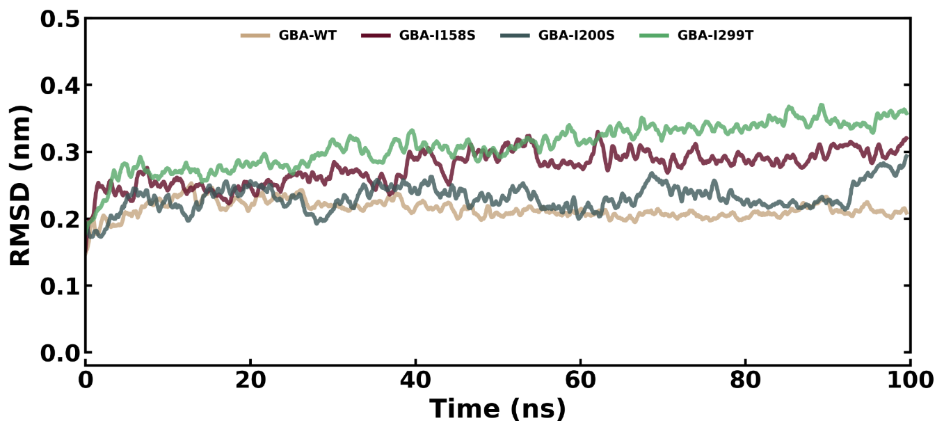
Root Mean Square Deviation (RMSD)
RMSD Conformational dynamics analysis of GBA-WT, GBA-I158S ,GBA-I200S, and GBA-I299T

Slide 53
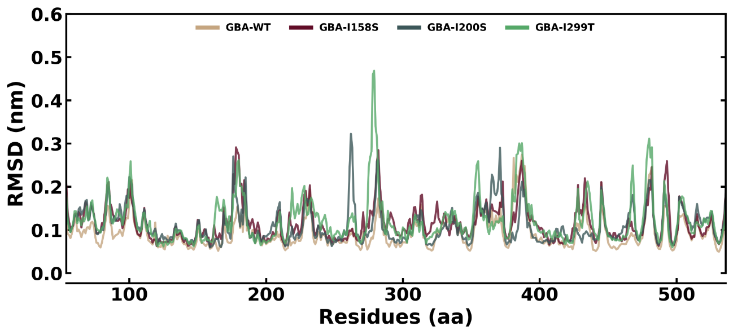
Root Mean Square Fluctuation (RMSF)
RMSF Conformational dynamics analysis of GBA-WT, GBA-I158S, GBA-I200S and GBA-I299T.

Slide 54
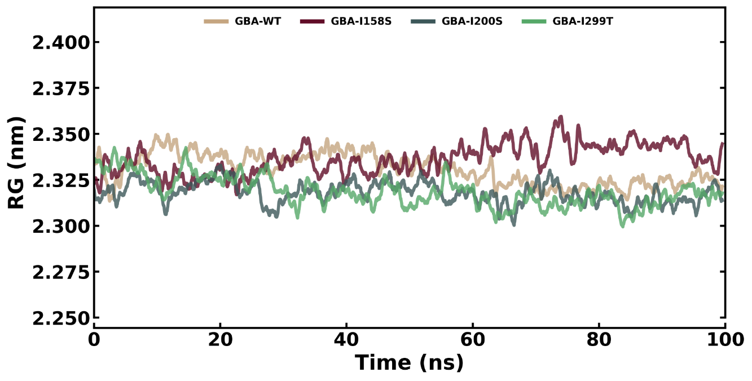
Radius of gyration (Rg)
Rg Conformational dynamics analysis of GBA-WT, GBA-I158S, GBA-I200S, and GBA-I299T.

Slide 55
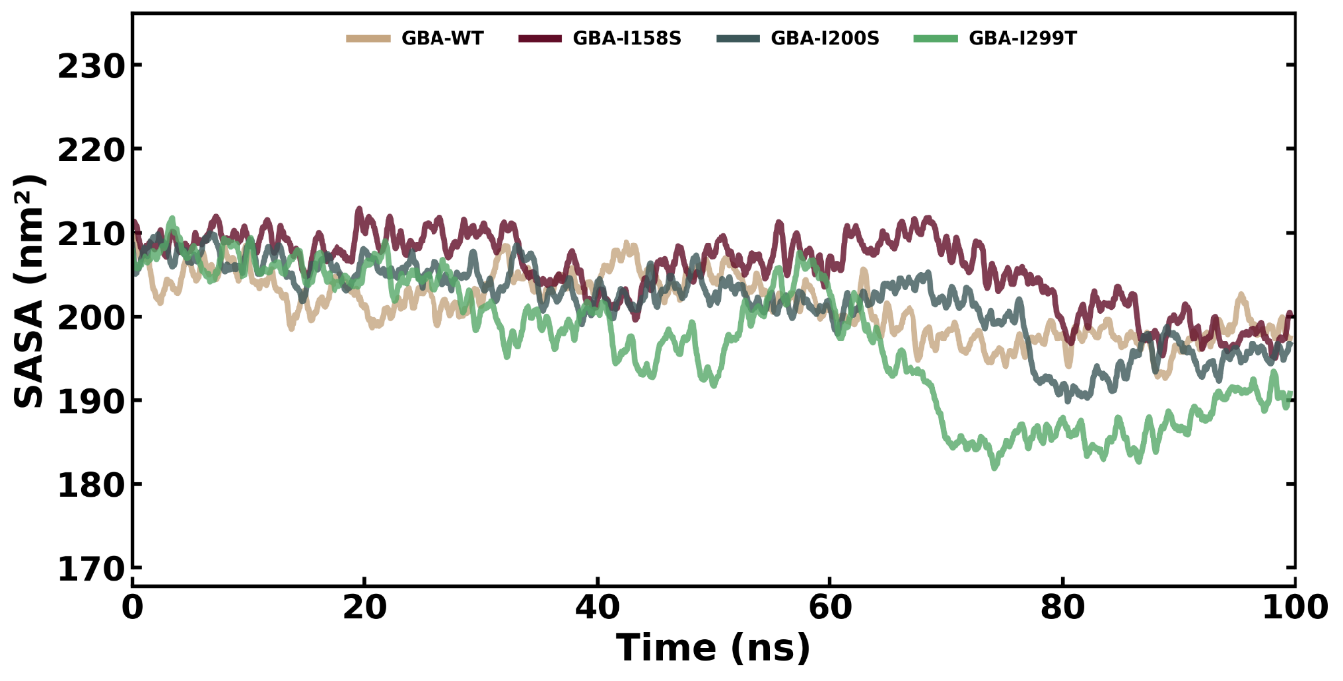
Solvent accessible surface area (SASA)
SASA Conformational dynamics analysis of GBA-WT, GBA-I158S, GBA-I200S, and GBA-I299T.

Slide 56
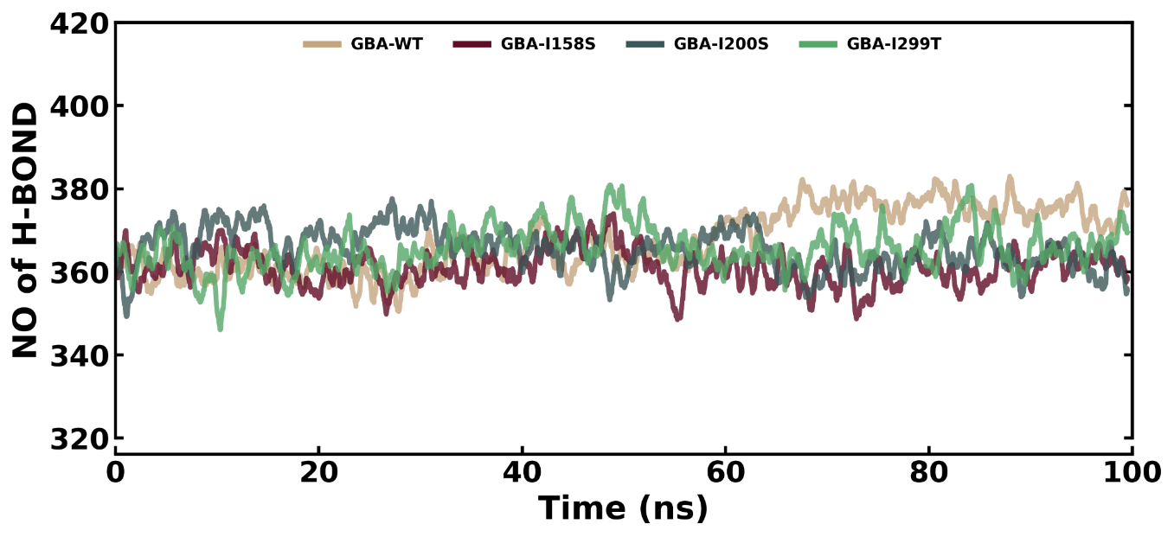
Intra Hydrogen Bond
. Intramolecular hydrogen bonds of GBA-WT, GBA-I158S, GBA-I200S, and GBA-I299T during the simulation time.

Slide 57
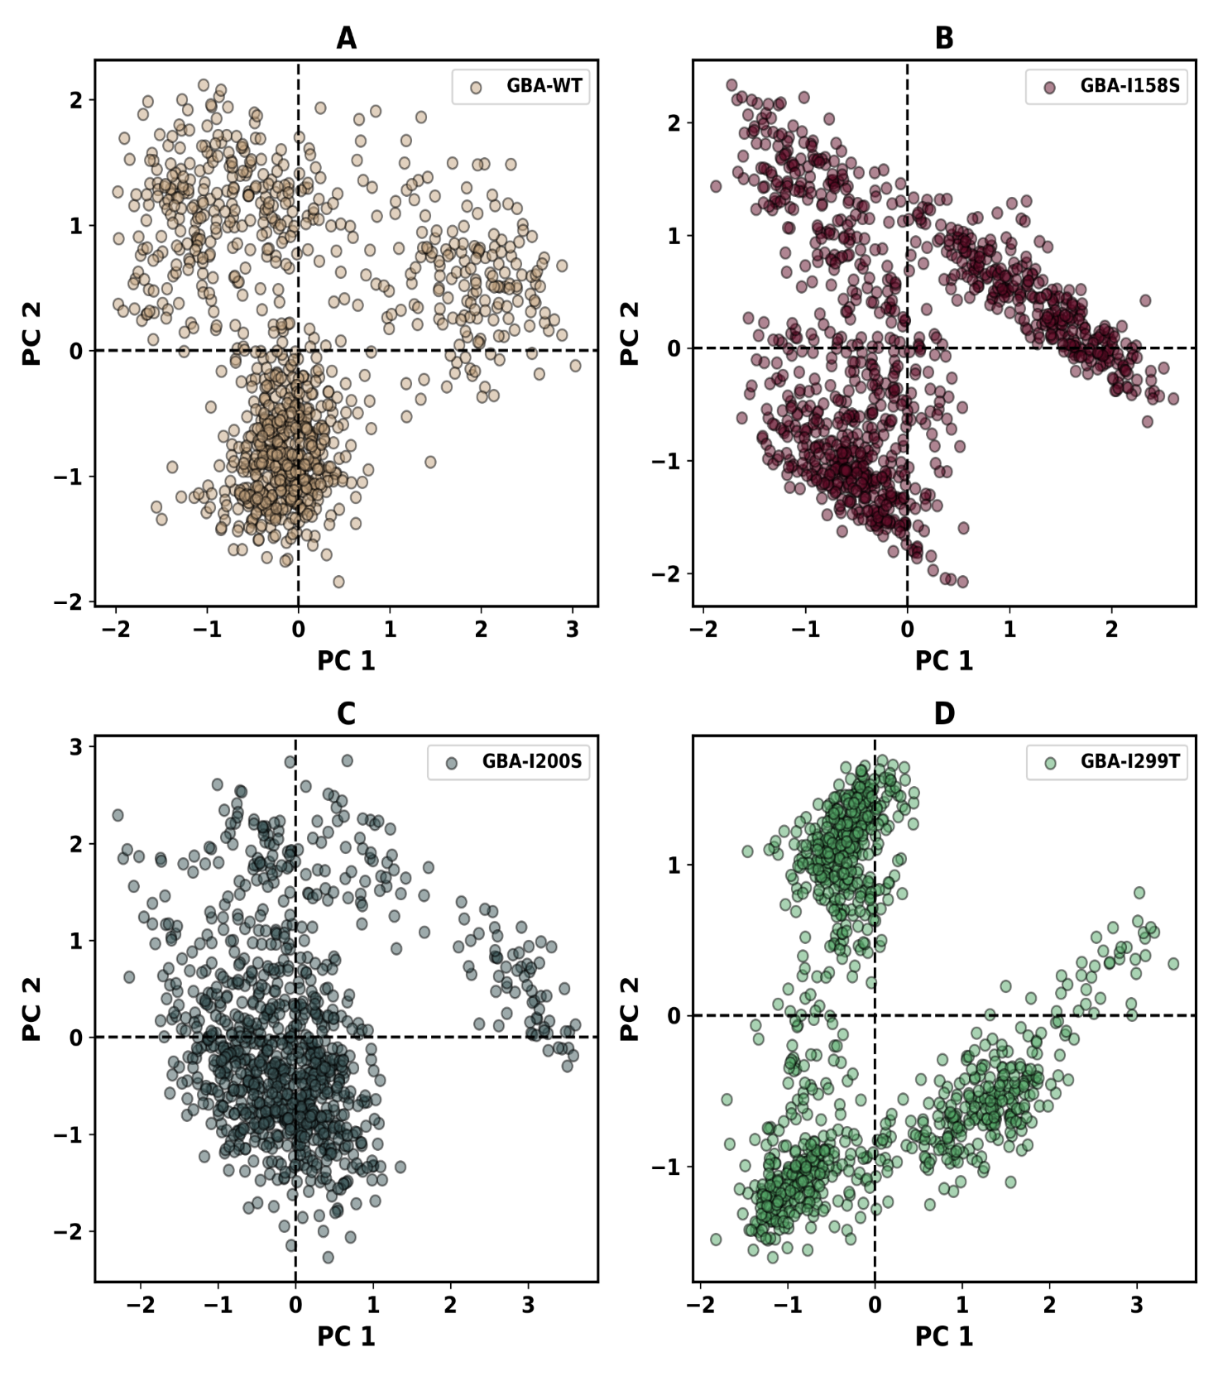
Principal Component Analysis (PCA)
Principal component analysis 2D projection plot shows the conformation sampling of, GBA-WT, GBA-I158S on PC1 and PC2.

Slide 58
Principal component analysis 2D projection plot shows the conformation sampling of GBA-I200S, and GBA-I299T on PC1 and PC2.

Slide 59
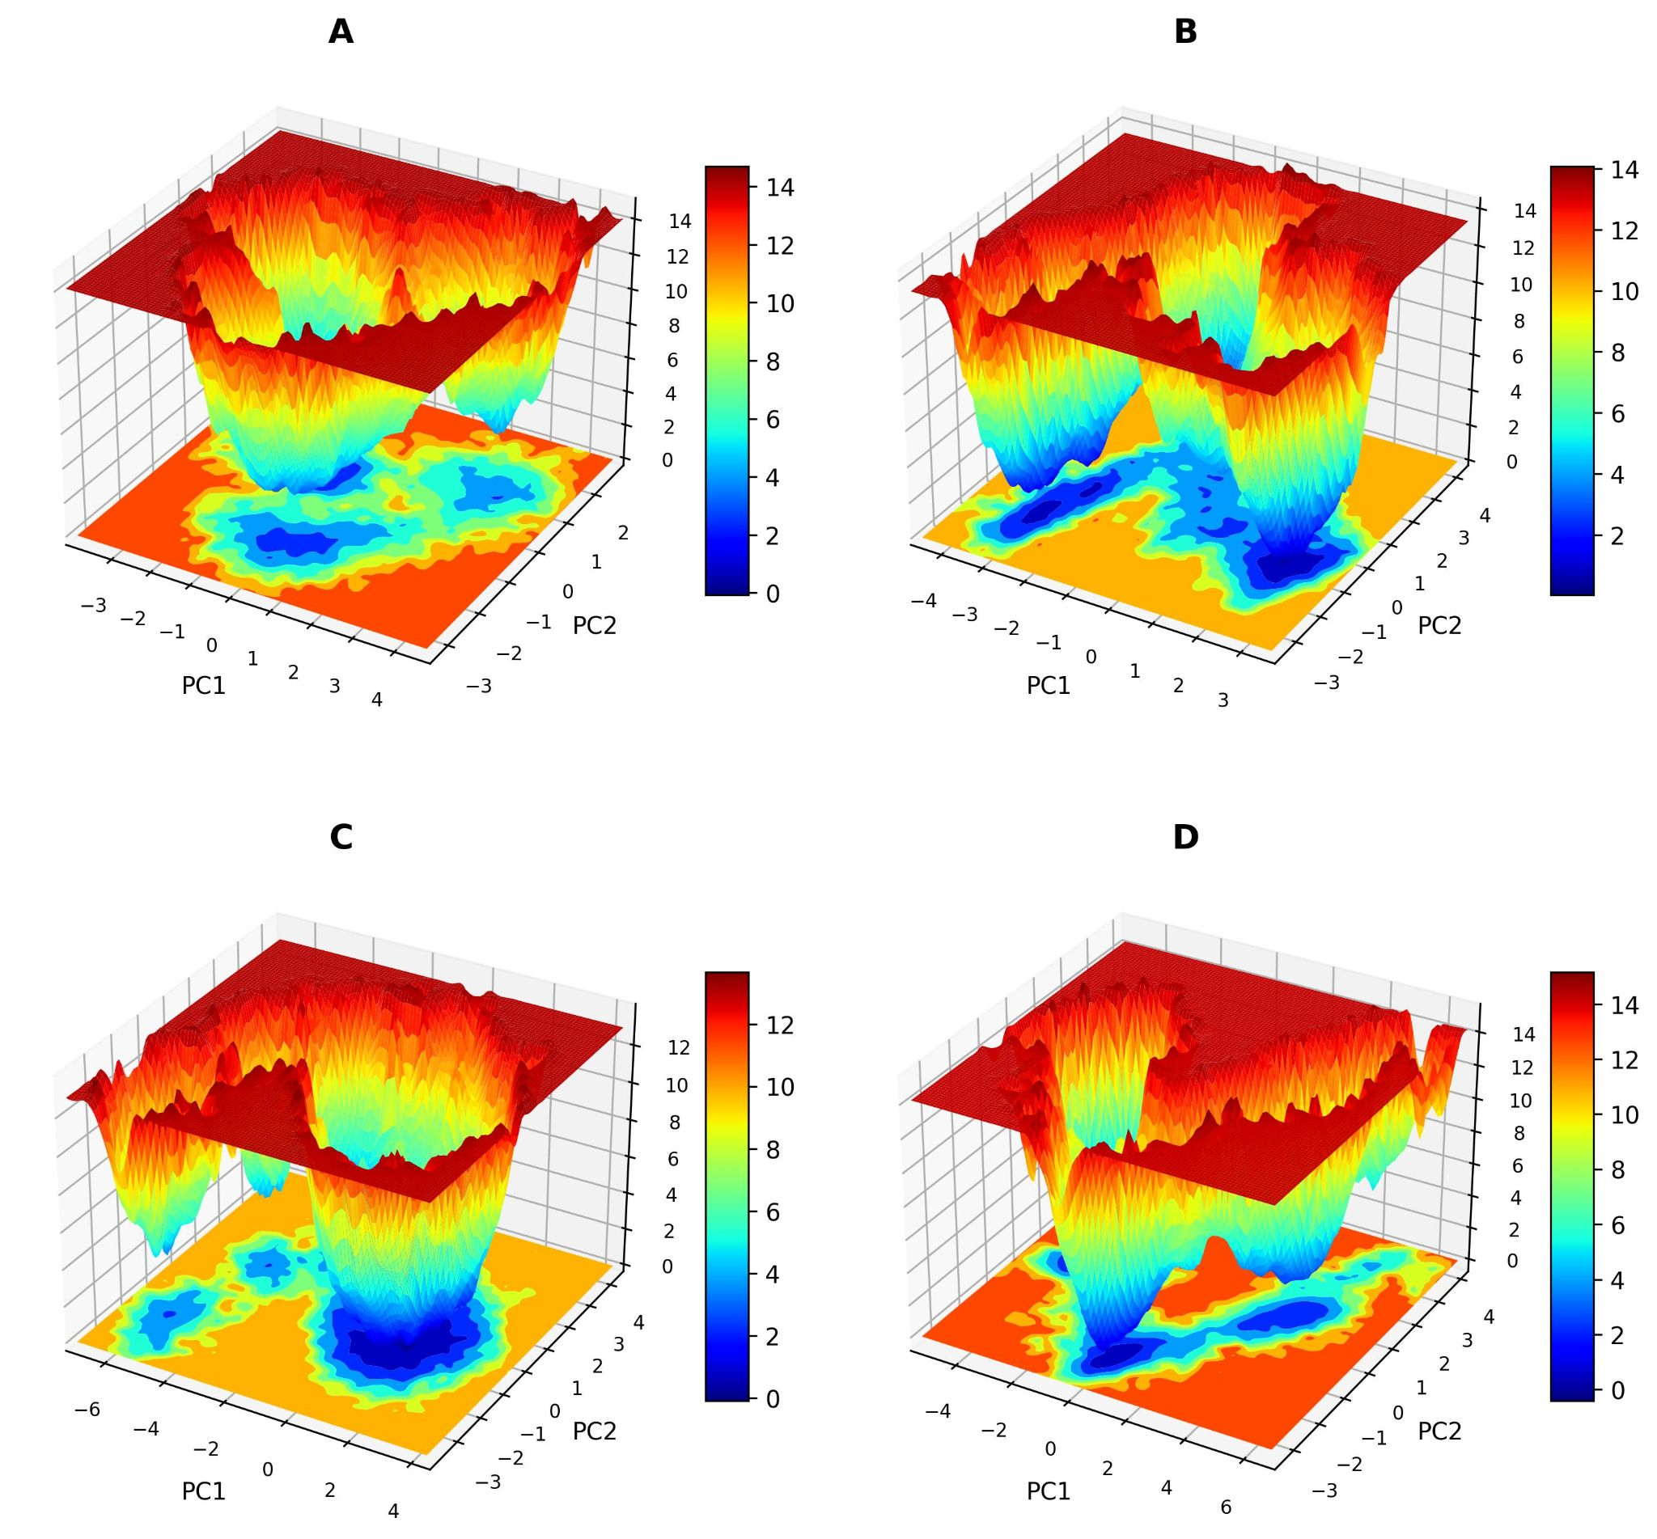
Free Energy Landscapes (FELs)
The free energy landscape plots for (A)GBA-WT, (B)GBA-I158S,

Slide 60
The free energy landscape plots for (C)GBA-I200S , and (D)GBA-I299T.

Slide 61
References

Slide 62
References
https://scholar.google.com/scholar?hl=en&as_sdt=0,5&qsp=2&q=type+1+gaucher%27s+disease&qst=ib#d=gs_qabs&t=1733150615188&u=%23p%3D5AZl8UiLQwQJ
https://scholar.google.com/scholar?hl=en&as_sdt=0,5&qsp=2&q=type+1+gaucher%27s+disease&qst=ib#d=gs_qabs&t=1733151877695&u=%23p%3DweYv6vcvn58J
https://www.jpeds.com/article/S0022-3476(03)00814-X/abstract
https://scholar.google.com/scholar?hl=en&as_sdt=0%2C5&q=type+1+gaucher%27s+disease+with+GBA+gene+mutations++&btnG=#d=gs_qabs&t=1733152295629&u=%23p%3DZSh-BG6FQMAJ
https://scholar.google.com/scholar?hl=en&as_sdt=0%2C5&q=type+1+gaucher%27s+disease+with+GBA+gene+mutations++&btnG=#d=gs_qabs&t=1733154330664&u=%23p%3Dgek3fTQvOx8J
A Review of Gaucher Disease Pathophysiology, Clinical Presentation and Treatments - PMC

Slide 63
THANK YOU

